Slide 1

Pediatric Unfolding Case Study
Respiratory

Slide 2
Clinical Judgment
Recognize Cues
What assessment findings require follow-up?
Analyze Cues
What are the potential complications for this client?
Prioritize Hypotheses
What is the client at highest risk for due to which findings?
Generate Solutions
What medications/treatment do you anticipate for this client?
Take Action
What actions do you anticipate to prioritize in the plan of care?
Evaluate Outcomes
What parameters should be monitored to evaluate client outcomes?

Slide 3
Recognize Cues
Health History
Nurse’s Notes
Imaging Studies
Lab Results
A 2-month-old infant brought into the pediatrician’s office for a well-child visit. Mom has additional concerns.
Which of the assessment findings require follow-up?
Born at 32 weeks’ gestation via spontaneous vaginal delivery Birth weight = 2054 grams (4 lbs 8.3 oz.) Current weight = 7 lb 9.6 oz Uncomplicated NICU stay x 5 weeks Mother reports that older sibling has a “cold” Mother reports that infant has not eaten well today HR = 156 beats/min RR = 66 breaths/minute Nasal flaring Substernal retractions Makes soft sounds with each exhalation Pale pink mucous membranes Anterior fontanel soft and flat Quiet and arouses slightly during assessment

Slide 4
Recognize Cues
Health History
Nurse’s Notes
Imaging Studies
Lab Results
Born at 32 weeks’ gestation via spontaneous vaginal delivery Birth weight = 2054 grams (4 lbs 8.3 oz.) Uncomplicated NICU stay x 5 weeks Mother reports that older sibling has a “cold” Mother reports that infant has not eaten well today HR = 156 beats/min (a little high? What is normal for a 2-month-old?) RR = 66 breaths/minute Nasal flaring Substernal retractions Makes soft sounds with each exhalation Pale pink mucous membranes Anterior fontanel soft and flat Very quiet and arouses only slightly during assessment

Slide 5
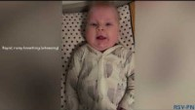
Bronchiolitis
Notes:
Added to case study

Slide 6
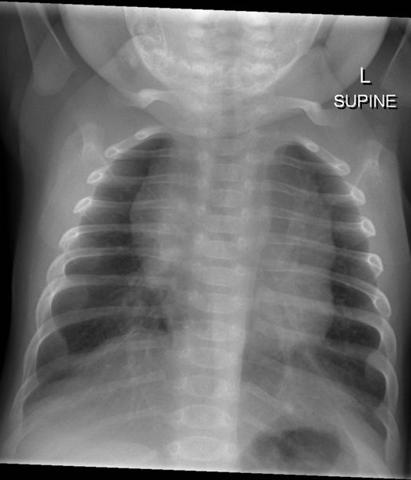
More Clues….
Notes:
Is the CXR normal?
Hyperinflation, patchy infiltrates and a large thymus – the thymus gradually disappears between 2 and 8 years of age.
The likely diagnosis is bronchiolitis.
CXR findings in bronchiolitis include non-specific patchy infiltration and hyperinfiltration, focal atelectasis, air trapping and diaphragmatic flattening)

Slide 7
Recognize Cues
Health History
Nurse’s Notes
Imaging Studies
Lab Results
Hgb: 11.6 (12-16 g/dL) Hct: 33.9 (36-48%) Plt: 400 (140,000-400,000/mcL) WBC: 17.8 (5,000-10,000/mcL) Viral PCR panel results = (-) adenovirus (-) influenza A & B), (+) respiratory syncytial virus, (-) rhinovirus

Slide 8
Recognize Cues
Health History
Nurse’s Notes
Imaging Studies
Lab Results
Hgb: 11.6 (12-16 g/dL) Hct: 33.9 (36-48%) Plt: 400 (140,000-400,000/mcL) WBC: 17.8 (5,000-10,000/mcL) Viral PCR panel results = (-) adenovirus (-) influenza A & B), (+) respiratory syncytial virus, (-) rhinovirus
Notes:
All viral, no bacterial

Slide 9
Multiple Response Select N (Recognize Cues)
Health History
Nurse’s Notes
Imaging Studies
Lab Results
The 2-month-old is admitted to the pediatric unit with the following nursing note. Select three client findings that are of immediate concern to the nurse.
  Pain
  Current weight
  Vital signs
  Heart rate
  Lab values
  Hemodynamic status
1000: Lung sounds coarse; crackles and diminished breath sounds in lower lobes, and intercostal retractions noted, RR = 76 breaths/min. Copious amounts of clear nasal secretions. Regular heart rate and rhythm, brachial pulses +2/=, pale mucous membranes, capillary refill = 4-5 seconds
Notes:
Vital signs, Lab values, hemodynamic status

Slide 10
Multiple Response Select N (Recognize Cues)
Health History
Nurse’s Notes
Imaging Studies
Lab Results
The 2-month-old is admitted to the pediatric unit with the following nursing note. Select three client findings that are of immediate concern to the nurse.
  Pain
  Current weight
  Vital signs
  Heart rate
  Lab values
  Hemodynamic status
1000: Lung sounds coarse; crackles and diminished breath sounds in lower lobes, and intercostal retractions noted, RR = 76 breaths/min. Copious amounts of clear nasal secretions. Regular heart rate and rhythm, brachial pulses +2/=, pale mucous membranes, capillary refill = 4-5 seconds
Notes:
Vital signs, Lab values, hemodynamic status

Slide 11
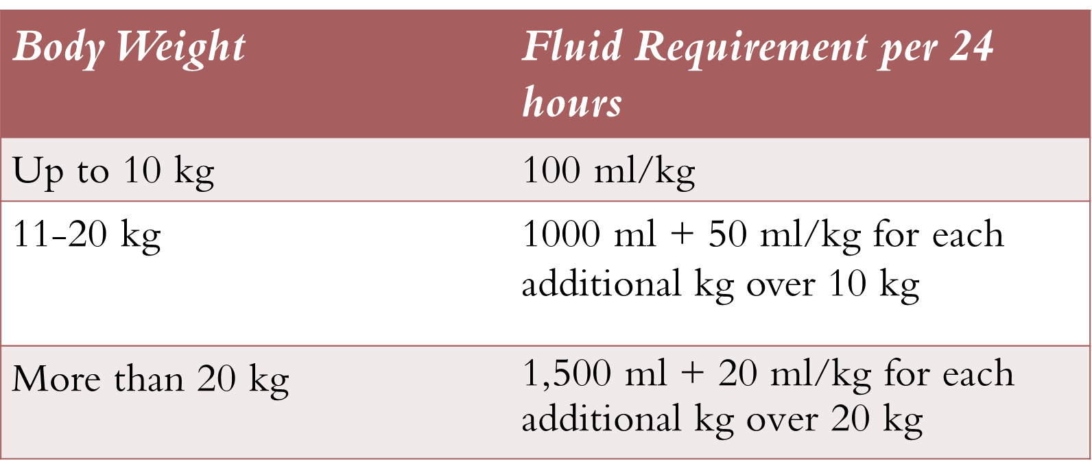
Medication Calculation
The nurse double-checks the hourly IV fluid rate of 14 ml/hr. Is this an acceptable maintenance fluid for a 2-month-old weighing 7 lb 9.6 oz?
Notes:
7 lb 9.6 oz = 9.6/16 = 0.6 + 7 = 7.6/2/2 = 3.45 kg 3.45(100) = 345 ml/kg/day divided by 24 = 14.4 ml/hr

Slide 12
Analyze Cues
Health History
Nurse’s Notes
Imaging Studies
Lab Results
1000: Lung sounds coarse; crackles and diminished breath sounds in lower lobes, and intercostal retractions noted, RR = 76 breaths/min. Copious amounts of clear nasal secretions. Regular heart rate and rhythm, brachial pulses +2/=, pale mucous membranes, capillary refill = 4-5 seconds
Based on the most recent assessment findings, which nursing interventions are indicated at this time?

Slide 13
Matrix Multiple Response (Analyze Cues)
 | Indicated | Not indicated
Administer antibiotics
Monitor oxygen saturation levels
Encourage oral clear liquids
Provide nasal suctioning as needed
Administer opioid pain medication
Maintain accurate I & O
Maintain prescribed IV fluids at 14 ml/hr
Instruct the mother to pump and store breastmilk

Slide 14
Matrix Multiple Response (Analyze Cues)
 | Indicated | Not indicated
Administer antibiotics |  | X
Monitor oxygen saturation levels | X
Encourage oral clear liquids |  | X
Provide nasal suctioning as needed | X
Administer opioid pain medication |  | X
Maintain accurate I & O | X
Maintain prescribed IV fluids at 14 ml/hr | X
Instruct the mother to pump and store breastmilk | X

Slide 15
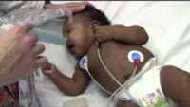
Your turn to assess….
Notes:
https://www.youtube.com/watch?v=lIE_UElOk3c

